Slide 1
Illumination models
Unit 5
1

Slide 2
Illumination and surface rendering model
Once visible surface has been identified by hidden surface algorithm, a shading model is used to compute the intensities and color to display for the surface. For realistic displaying of 3d scene it is necessary to calculate appropriate color or intensity for that scene.
Illumination model or a lighting model is the model for calculating light intensity at a single surface point. Sometimes also referred to as a shading model.
An illumination model is also called lighting model and some times called as a shading model which is used to calculate the intensity of light that we should see at a given point on the surface of a object.
A surface-rendering algorithm uses the intensity calculations from an illumination model.
Components of Illumination model
Light Sources: type , color, and direction of the light source
Surface Properties : réflectance, opaque/transparent, shiny/dull.
2

Slide 3
Illumination And Rendering
An illumination model in computer graphics
also called a lighting model or a shading model
used to calculate the color of an illuminated position on the surface of an object
Approximations of the physical laws
A surface-rendering method determine the pixel colors for all
projected positions in a scene

Slide 4
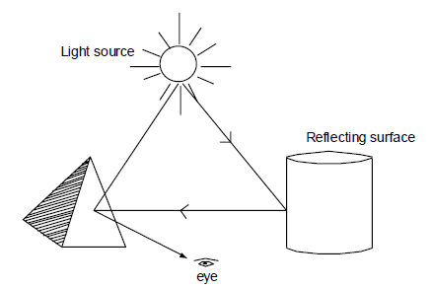
Light Source
Object that radiates energy are called light sources, such as sun, lamp, bulb, fluorescent tube etc.
Sometimes light sources are referred as light emitting object and light reflectors. Generally light source is used to mean an object that is emitting radiant energy e.g. Sun.
Total Reflected Light = Contribution from light sources +
contribution from reflecting surfaces

Slide 5
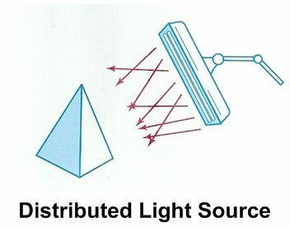
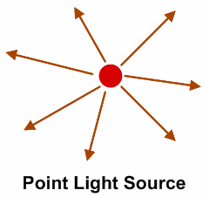
Light Source..
Point Source:
Point source is the simplest light emitter e.g. light bulb. when light source model is a reasonable approximation for sources whose dimensions are small compared to the size of objects in a scene.
Distributed Light Source:
area of source is not small compared to the surfaces in the
scene e.g. Fluorescent lamp

Slide 6
Reflection of light:
When light is incident on opaque surface part of it is reflected and part of it is absorbed.
∴ I = A+R
The amount of incident light reflected by a surface depends on the type of material. Shining material reflects more incident light and dull surface absorbs more of the incident light. For transparent surfaces, some of the incident light will be reflected and some will be transmitted through the material.

Slide 7

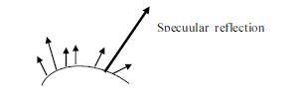
Distributed light source
When light is incident on an opaque surface part of it is reflected and part of it is absorbed.
Surface that are rough or grainy, tend to scatter the reflected light in all direction which is called diffuse reflection.
When light sources create highlights, or bright spots, called
specular reflection

Slide 8
Light Source..
Point source: Simplest model for a light emitter like tungsten filament bulb
Distributed light source: The area of the source is not small compared to the surfaces in the scene like fluorescent light on any object in a room
Diffuse reflection: Scatter reflected light in all direction by
rough or grainy surfaces.
Specular-reflection: highlights or bright spots created by light source, particularly on shiny surfaces than on dull surfaces.

Slide 9
Illumination models:
Illumination models are used to calculate light intensities that we should see at a given point on the surface of an object. Lighting calculations are based on the optical properties of surfaces, the background lighting conditions and the light source specifications. All light sources are considered to be point sources, specified with a co-ordinate position and an intensity value (color). Some illumination models are:
Ambient Light
Diffuse Reflection
Specular Reflection and phong model

Slide 10
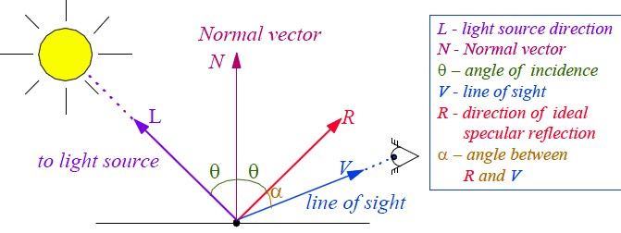
Some useful concept

Slide 11
1. Ambient light:
This is a simplest illumination model
We can think of this model, which has no external light source-self-luminous objects. A surface that is not exposed directly to light source still will be visible if nearby objects are illuminated.
The combination of light reflections form various surfaces to produce a uniform illumination is called ambient light or background light.
Also called background light
Ambient light means the light that is already present in a scene, before any additional lighting is added. It usually refers to natural light, either outdoors or coming through windows etc. It can also mean artificial lights such as normal room lights.
11

Slide 12
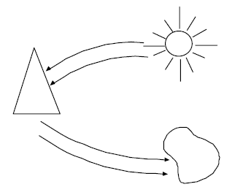
1. Ambient light:
12

Slide 13
1. Ambient light …
Multiple reflection of nearby (light-reflecting) objects yields a uniform illumination
A form of diffuse reflection independent of the viewing direction
and the spatial orientation of a surface
Ambient light has no spatial or directional characteristics and
all
amount on each object is a constant for all surfaces and
directions. In this model, illumination can be expressed by an illumination equation in variables associated with the point on the object being shaded. The equation expressing this simple model is
I=K_{a}
Where I is the resulting intensity and K_{a} is the object’s intrinsic intensity.
13

Slide 14
1. Ambient light …
If we assume that ambient light impinges equally on all surface from all direction, then
I = I_{a} K_{a}
Where I_{a} is intensity of ambient light.
K_{a} is object’s intrinsic intensity.
The amount of light reflected from an object's surface is determined by K_{a} , the ambient-reflection coefficient.K_{a} ranges from 0 to 1.
14

Slide 15
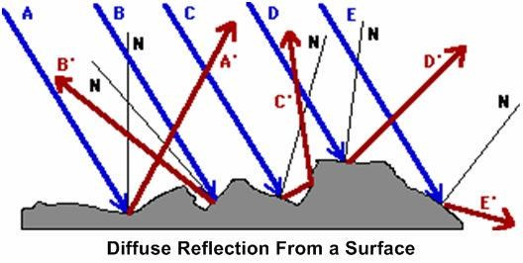
2. Diffuse Reflection
Objects illuminated by ambient light are uniformly illuminated across their surfaces even though light are more or less bright in direct proportion of ambient intensity.
Surfaces are rough
Incident light is scattered with equal intensity in all directions
Surfaces appear equally bright from all direction.
Such surfaces are called ideal diffuse reflectors (also referred to as Lambertian reflectors)

Slide 16
2. Diffuse Reflection…
Illuminating object by a point light source,
whose rays
enumerate uniformly in all directions from a single point. The object's brightness varies form one part to another, depending on the direction of and distance to the light source.
Color of an object is determined by the color of the diffuse reflection of the incident light.
If any object surface is red then there is a diffuse reflection for red component of light and all other components are absorbed by the surface.

Slide 17
2. Diffuse Reflection…
The diffuse-reflection coefficient, or diffuse reflectivity, kd (varying from 0 to 1) define the fractional amount of the incident light that is diffusely reflected.
The parameter k_{d} (actually function of surface color)depends on the reflecting properties of material so for highly reflective surfaces, the k_{d} nearly equal to 1.
If a surface is exposed only to ambient light, we can express the intensity of the diffuse reflection at any point on the surface as:
I_{amb},Diff = k_{d} . I_{a}, (where I_{a} = intensity of ambient light)

Slide 18
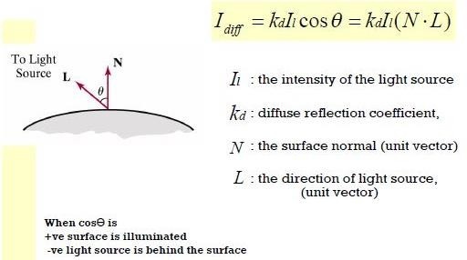
2. Diffuse Reflection…
If N is the unit normal vector to a surface and L is the unit direction vector to the point light source from a position on the surface then cos θ = N.L ( Lambertian Cosine Law) and the diffuse reflection equation for single point source illumination is:
I_{L}, diff = k_{d} . I_{L} cos θ = k_{d} I_{L} (N.L)

Slide 19


2. Diffuse Reflection…
We can combine the ambient and point source intensity
calculations to obtain an expression reflection. Thus, we can write the
for the total diffuse total diffuse reflection
equation as:
I_{Diff} = k_{d} . I_{a} + k_{d} I_{L} (N.L)
ambient
Diffuse for single point

Slide 20
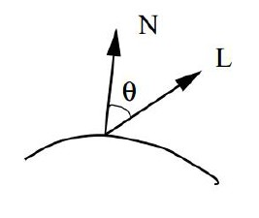
_{Lambert’s Cosine} Law:
The intensity of diffuse reflection due to ambient light is;
^{I}adiff ^{= k}a^{I}a
The radiant energy from any small surface dA in any direction relative to surface normal is proportional to cos 𝜃. That is, brightness depends only on
the angle θ between the light direction L and the surface normal N.
∴ Light intensity α cos 𝜃.
If I_{l} is the intensity of the point light source and k_{d} is the diffuse reflection coefficient,
then the diffuse reflection source can be written as; Ι_{pdiff} = k_{d}I_{l} cosθ
Ι_{pdiff} = k_{d}Ι_{l} (Ν ∙L)
for single point-
Fig: Angle of incidence θ between the unit light-source direction vector L and the unit surface normal
∴ Total diffuse reflection (Idiff) = Diff ( due to ambient light)+Diff. due to pt.source.
^{I}diff ^{= I}adiff ^{+ Ι}pdiff
I_{diff} = k_{a}I_{a} + k_{d}Ι_{l} (Ν ∙L)
20

Slide 21
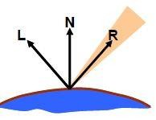
3. Specular reflection and phong model
When we look at an illuminated shiny surface, such as polished metal, a person's forehead, we see a highlight or bright spot, at certain viewing direction. Such phenomenon is called specular reflection.
It is the result of total or near total reflection of the incident light in a concentrated region around the " specular reflection angle = angle of incidence".
Perfect reflector (mirror) reflects all lights to the direction where angle of reflection is identical to the angle of incidence
It accounts for the highlight
21

Slide 22
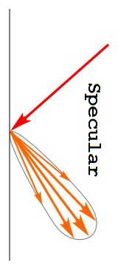
22

Slide 23
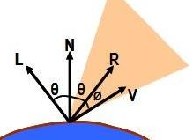
3. Specular reflection and phong model
Let SR angle = angle of incidence as in figure.
N -
unit vector normal to surface at
incidence point
unit vector in the direction of ideal specular reflection.
unit vector directed to words
point light source.
unit vector pointing to the viewer from surface.
the viewing angle relative to the
specular reflection direction.
R -
Nipun Thapa (Computer)
L -
V -
Ø−
23

Slide 24
3. Specular reflection and phong model
For ideal reflector (perfect mirror), incident light is reflected only in the specular reflection direction.
V & R concide (Ø = 0)
Shiny surface have narrow Ø and dull surface wider Ø .
An empirical model for calculating specular-reflection range developed by Phong Bui Tuong-called Phong specular reflection model (or simply Phong model), sets the intensity of specular reflection proportional to cos^{ns} Ø →0 to 90⁰ .
Specular reflection parameter n_{s} is determined by type of surface
Intensity of specular reflection depends upon material properties of the surface and ɵ . Other factors such as the polarization and color of the incident light.
- For monochromatic specular intensity variations can approximated by SR coefficient w(ɵ)
24

Slide 25
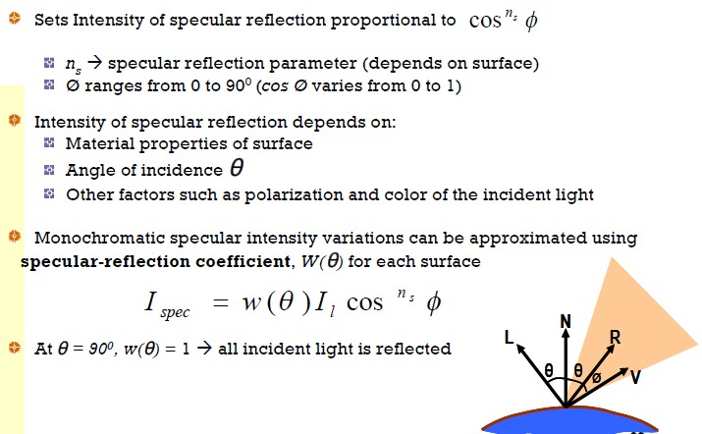
3. Specular reflection and phong model
25

Slide 26
3. Specular reflection and phong model
Fresnal's law of reflection describe specular reflection intensity with and using w(ɵ ) , Phong specular reflection model as
I _{spec} = w(ɵ) I_{L} cos^{ns} Ø
Where I_{l} is intensity of light source. is viewing angle relative to SR direction R. For a glass, we can replace w(ɵ) with constant Ks specular reflection coefficient.
So,
I _{spec} = K_{s} I_{L} cos^{ns} Ø
= K_{s} I_{L} (V.R)^{ns} since cosØ = V.R
26

Slide 27
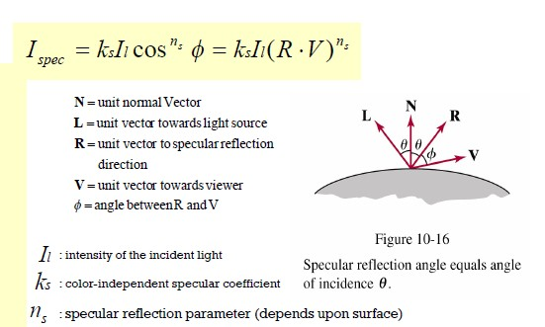
3. Specular reflection and phong model
27

Slide 28

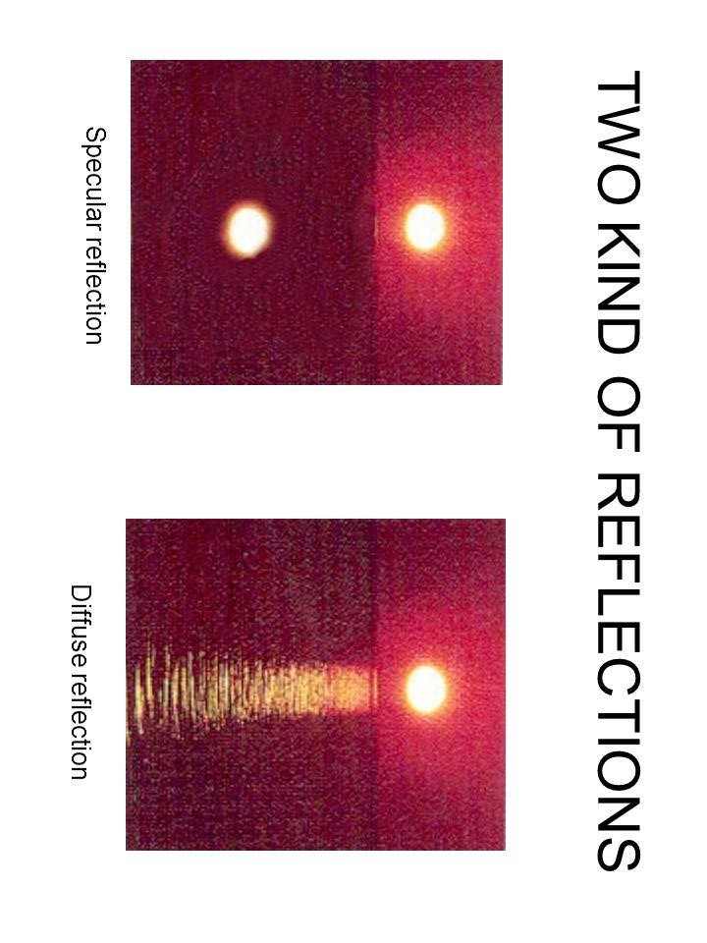
28

Slide 29
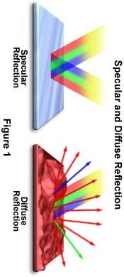
29

Slide 30
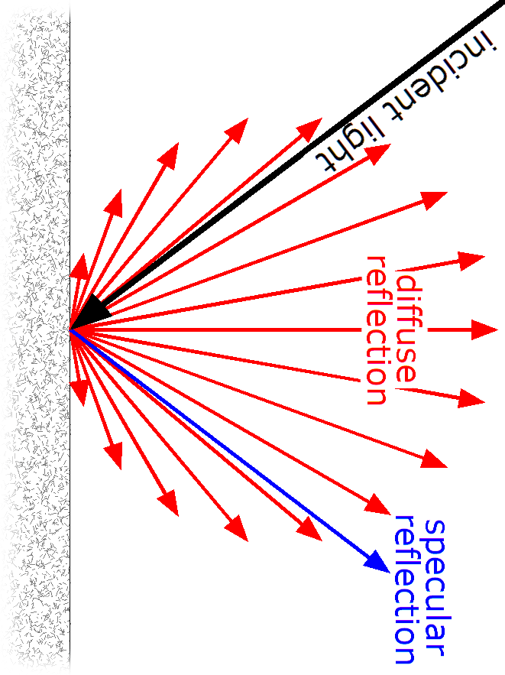
30

Slide 31
Polygon Rendering Method
(Surface Shading Method)
Objects usually polygon-mesh approximation
Illumination model is applied to fill the interior of polygons
Curved surfaces are approximated with polygon meshes
But polyhedra that are not curved surfaces are also modeled with polygon meshes
Two ways of polygon surface rendering:
Single intensity for all points in a polygon
Interpolation of intensities for each point in a polygon
Methods:
Constant Intensity Shading
Gouraud Shading
Phong Shading
38

Slide 32
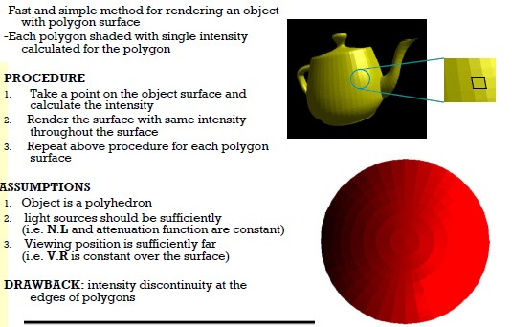
1. Constant Intensity Shading

Slide 33
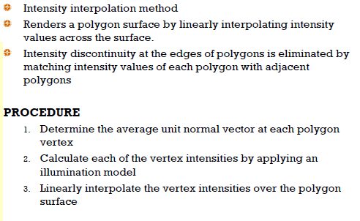
2. Gouraud Shading

Slide 34
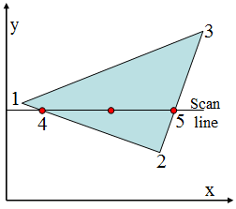

2. Gouraud Shading…..
For Gouraud shading, the intensity at point 4 is linearly interpolated from the intensities at vertices 1 and 2.
The intensity at point 5 is linearly interpolated from intensities at vertices 2 and 3.
An interior point p is then assigned an intensity value that is linearly interpolated from intensities at positions 4 and 5.
p

Slide 35
2. Gouraud Shading…..
Advantages:
Removes discontinuities of intensity compared to constant shading model
at the edge
Limitations:
Highlights on the surface are sometimes displayed with anomalous(irregular) shapes and linear intensity interpolation can cause bright or dark intensity streaks, called Mach Bands to appear on the surfaces. Mach bands can be reduced by dividing the surface into a greater number of polygon faces or Phong shading (requires more calculation).
42

Slide 36
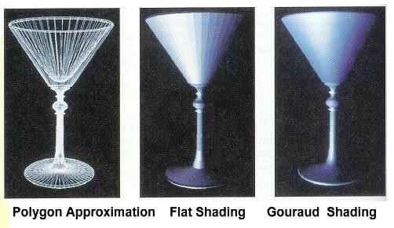

Surface Rendering
43

Slide 37
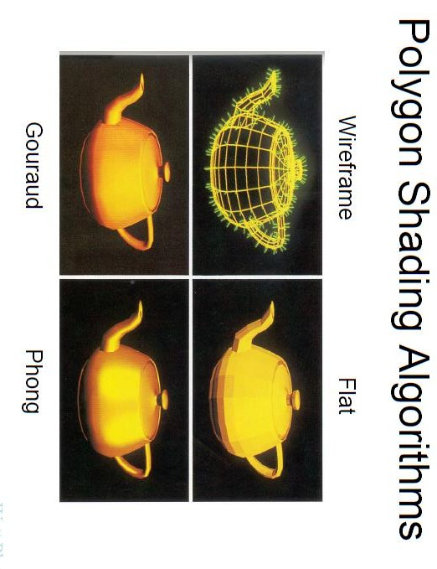
44

Slide 38
3.Phong Shading
A more accurate method for rendering a polygon surface is Phong shading, or normal vector interpolation shading which first interpolate normal vectors, and then apply the illumination model to each surface point. It displays more realistic highlights on a surface and greatly reduces the Mach- band effect.
A polygon surface is rendered using Phong shading by carrying
out the following steps:
Determine the average unit normal vector at each polygon vertex.
Linearly interpolate the vertex normals over the surface of the polygon.
Apply an illumination model along each scan line to calculate
projected pixel intensities for the surface points.
45

Slide 39
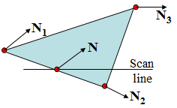

3.Phong Shading
The normal vector N for the scan-line intersection point along the edge between vertices 1 and 2 can be obtained by vertically interpolating between edge endpoint normal:
Incremental methods are used to evaluate normal between scan lines and along each individual scan line (as in Gouraud). At each pixel position along a scan line the illumination model is applied to determine the surface intensity at that point. Intensity calculations using an approximated normal vector at each point along the scan line produce more accurate results than the direct interpolation of intensities, as in Gouraud shading but it requires considerable more calculations.
46

Slide 40
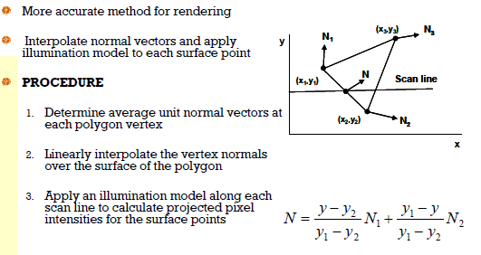
3.Phong Shading

Slide 41
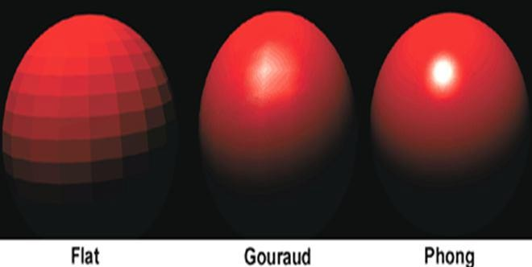
Gouraud Vs Phong Shading
Gouraud shading is faster than Phong shading
Phong shading is more accurate

Slide 42
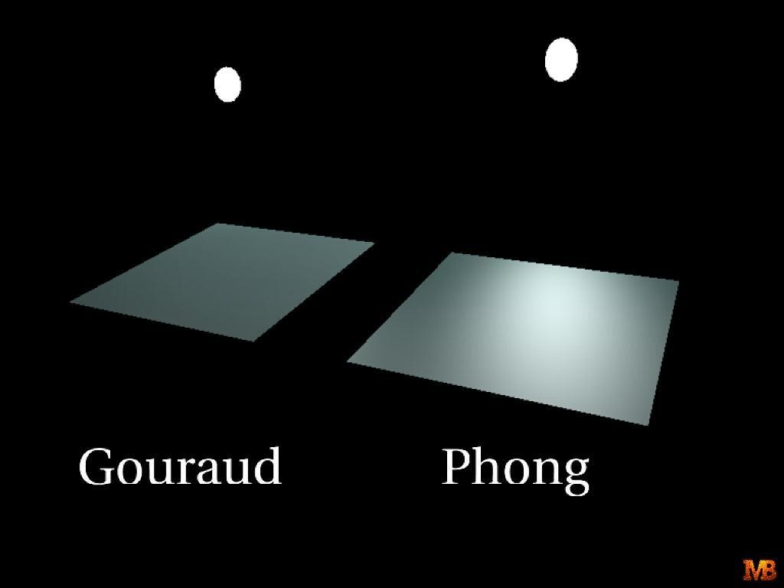
Gouraud Vs Phong Shading
Gouraud shading is faster than Phong shading
Phong shading is more accurate

Slide 43
Color models: RGB

Slide 44
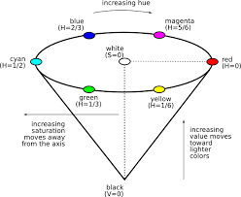
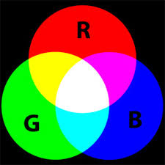
RGB :
The RGB color model is an additive color model in which red, green, and blue light are added together in various ways to reproduce a broad array of colors. The name of the model comes from the initials of the three additive primary colors, red, green, and blue.
HSL and HSV
HSL and HSV are alternative representations of the RGB color model, designed in the 1970s by computer graphics researchers to more closely align with the way human vision perceives color-making attributes .

Slide 45
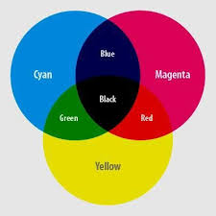
CMY:
The CMY color model is a subtractive color model in which cyan, magenta
and yellow pigments or dyes are added together in various ways to reproduce a broad array of colors. The name of the model comes from the initials of the three subtractive primary colors: cyan, magenta, and yellow.

